Slide 1

ITJuana Test Automation Bootcamp

Slide 2
Trainers introduction
Jenny Ramirez
Oscar Valerio
Alexis Hernandez
Brian Martinez
Jonathan Garcia
Notes:
Jenny

Slide 3
Agenda Day 1
9:45 - 10:30 | Brian | Testing overview
10:30 - 10:40 | All | Break
10:40 - 11:30 | Oscar | Test automation
11:30 - 12:00 | Oscar | Selenium
12:00 - 13:00 | All | Lunch time
13:00 - 14:30 | Oscar | Selenium
14:30 - 14:40 | All | Break
14:40 - 16:30 | Alexis | Automating web components
16:30 - 16:40 | All | Break
16:40 - 18:00 | Jenny | Automating web components
18:00 - 18:15 | All | Q&A and wrapping up the day
Notes:
Brian Martinez

Slide 4
1.
Software Testing
Basic concepts
Notes:
Brian Martinez

Slide 5
In god we trust, the rest we test.
Notes:
Brian Martinez

Slide 6
Topics
What is software testing?
Testing Activities
What is a test case?
Testing Scenarios
Where do test cases come from?
How to present our test results
Manual VS Automated tests.
Notes:
Brian Martinez

Slide 7
What is software testing?
Is a process that involves a different set of activities that help to:
Make sure the software does what it needs to do.
Identify errors in the different stages of the Software Development Life Cycle.
Reduce the risk of software failing in a production environment.
Protect the end user from a poor experience when using the software.
Notes:
Brian Martinez

Slide 8
Testing Activities
Test Planning
Test Monitoring
Test Analysis
Test Design
Test Implementation
Test Execution
Notes:
Brian Martinez

Slide 9
Test Case
Set of actions that executed will verify a particular functionality on the software.
Test Number
Description
Pre conditions
Test Steps
Test Data
Expected Results
Pos conditions

Slide 10
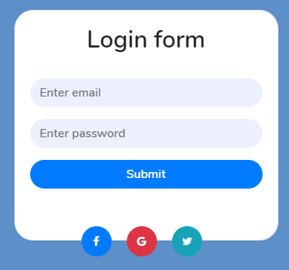
Test Case example (Login)
# | Test Case Description | Test Steps | Test Data | Expected Result
1 | Login | Enter Email Address Enter Password Click Sign in button | Email: user@email.com Password: 1234 | User gets redirected to the main page

Slide 11
Test Scenario (Login)
Login with gmail account
Login with right credentials
Login with wrong username
Login leave fields empty
Login with right username but wrong password
Forget username
Login with Facebook account
Forget password

Slide 12
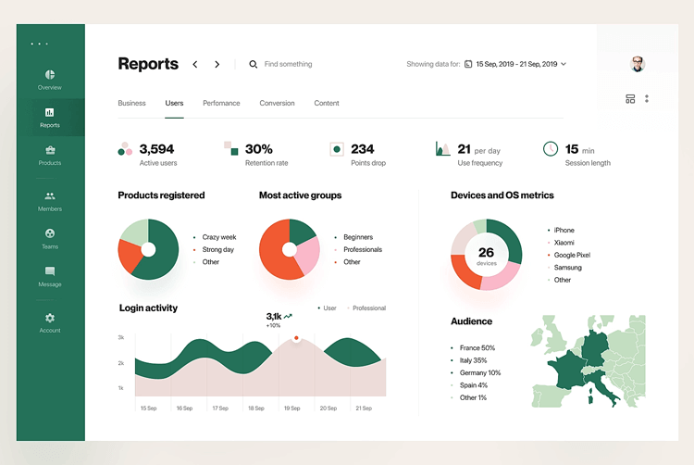

Slide 13
Requirement/User Story and Acceptance Criteria
Acceptance Criteria
Will be found as part of the User Story or Requirement.
Is a measurable criteria, formulated as a set of statements, which can be either true or false.
They are used to check whether a requirement or user story has been implemented as expected.
Represent the test conditions which determine “what” to test.
Requirement/User story
Will define the features and behavior that the product should have.

Slide 14
Example
As a user I want to be able to login into the system by different methods.
User should be able to use the @email.com account to login.
User should be able to login using a Facebook account.
User should be able to login using a Twitter account.
User should be able to login using a Gmail account.
If user type in the wrong email or password a message should be displayed “Wrong Credentials”

Slide 15

How to present our test results

Slide 16


Test run
Scenario #1
Requirement changes
Scenario #2
Developer’s new implementation

Slide 17
Manual Testing Vs Automated Testing
Manual
Tests executed by a human tester.
Exploratory testing is possible.
Initial investment is lower
UI changes does not affect the test execution.
Allows Human observation.
No need for programming experience.
Automated
Tests executed by an automation tool.
Execution takes less time.
It is reliable, does not cause testing fatigue.
Can be run in parallel and on different devices, OS, browsers.
Can run at anytime.
Generates an automatic test summary

Slide 18
2. Automation Testing
Notes:
Oscar

Slide 19
What is Automation Test?

Slide 20
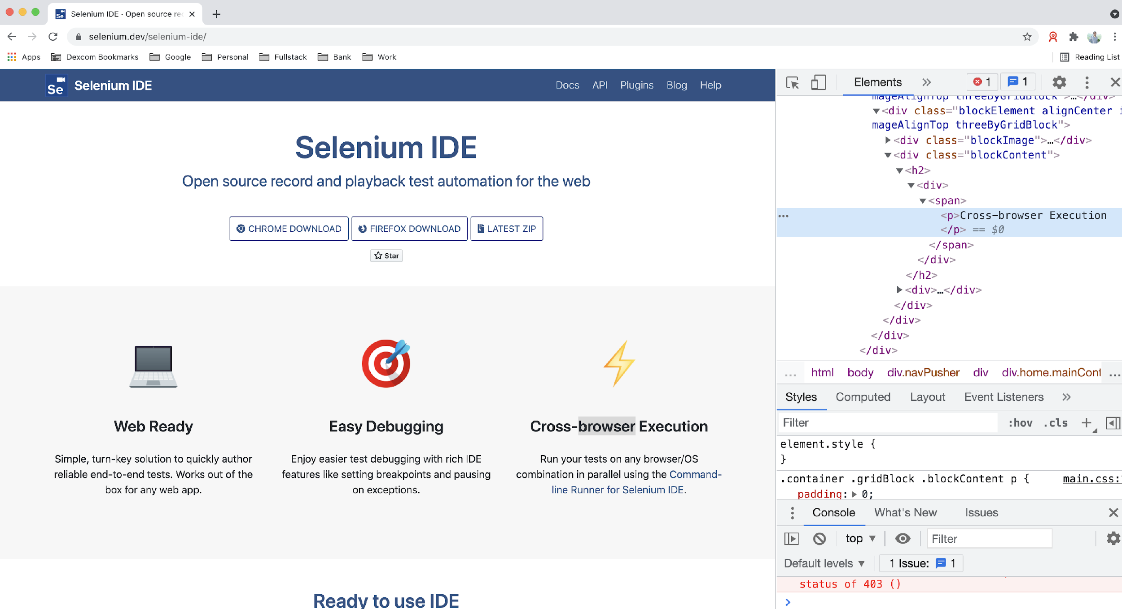
What is Automation Test?
Automation Test
Test automation is many things, we will define test automation as the automatic execution of functional tests, designed at least in some ways to simulate a human being executing manual tests.

Slide 21
Advantages and disadvantages of Automation Test?
Advantages
Performing some tests that cannot be performed at all (or easily) manually
Reducing the time needed for test execution
Increasing the frequency that some tests can be run
Reducing mistakes made by bored or distracted manual testers
Executing tests outside of normal business hours
Increasing confidence in the build
Disadvantages
Delays, costs, and mistakes associated with testers as they learn new technologies
In worst cases, complexity may become overwhelming
Considerable maintenance of tools, environments, and test assets required
The pesticide paradox is increased when automation is used since exactly the same test is run each time
Without clever programming in the automated tests, tools are literal minded and stupid;testers are not

Slide 22
Web Testing vs. Mobile Testing

Slide 23
Web Testing vs. Mobile Testing
Web Testing
A web application (app) is a program delivered through the internet in the form of a browser interface. Web app testing, or web testing, is a software testing practice that helps ensure the quality and functionalities of the app according to the requirements.
There are many types of Testing Techniques that can be applied to Web Testing:
Functionality Testing
Interface Testing
Compatibility Testing
Performance Testing

Slide 24
Web Testing vs. Mobile Testing
How to Test Web Apps
There are a few things that need to be tested when you’re checking the app behavior:
Test all links in your webpages are working correctly and make sure there are no broken links.
Test Forms are working as expected
Test Cookies are working as expected.
Test HTML and CSS.
Test business workflow.

Slide 25
Web Testing vs. Mobile Testing
Mobile Testing
There are three main types of mobile application:
Native: They are downloaded, installed and updated from supplier stores. These apps may need testing on all supported devices
Browser-based: These are accessed through a mobile browser and they use the typical web-development technologies and browsers,
Hybrid: Hybrid applications are a combination of native app and web app.

Slide 26
Web Testing vs. Mobile Testing
How to Test Mobile Apps?
We need to consider the following specific risks and challenges
The variety of mobile devices with device-specific defects on some of them.
The availability of devices in-house or via the use of external test labs.
The introduction of new technologies, devices and/or platforms during the application life cycle.
The installation and upgrade of the app itself via various channels, including preserving app data and preferences.
The ability to test using the networks of various service providers.
The use of mobile emulators, simulators and/or real devices for specific test levels and types of test

Slide 27
Web Testing vs. Mobile Testing
Challenges Testing Mobile Apps
Multiple OS types and versions, screen sizes and quality of display.
Multiple network types and providers.
Various distribution channels for apps.
Various types of sensors and difficulty in simulating test conditions for constrained CPU and RAM resources.
Marketplace publishing which requires additional approval cycles for publishing by marketplace owners such as Google Play or Apple App Store.

Slide 28
Exploring Web Elements
Notes:
Oscar

Slide 29
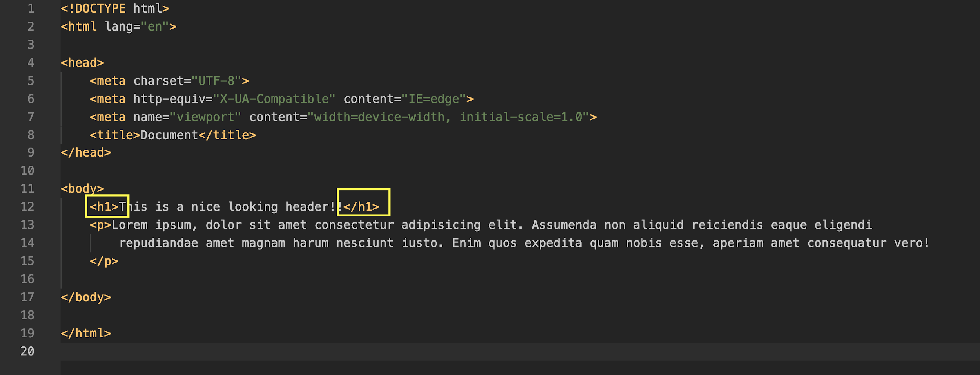
Exploring Web Elements
What’s HTML?
An HTML document is a plain text file which contains elements which specify certain contextual meanings when the document is parsed. HTML describes the structure of a web page semantically and the most important benefit to using HTML is the universal applicability of the language.
HTML elements are introduced and often surrounded by tags which are defined by angle brackets as seen below:

Slide 30
Exploring Web Elements
Our First HTML page (Exercise 1):
<h1> Heading tags define different levels of headers. The actual format of the text (size, boldness, font) can be specified in CSS stylesheets.
<p> Defines a paragraph
<b> Bold the text selected

Slide 31
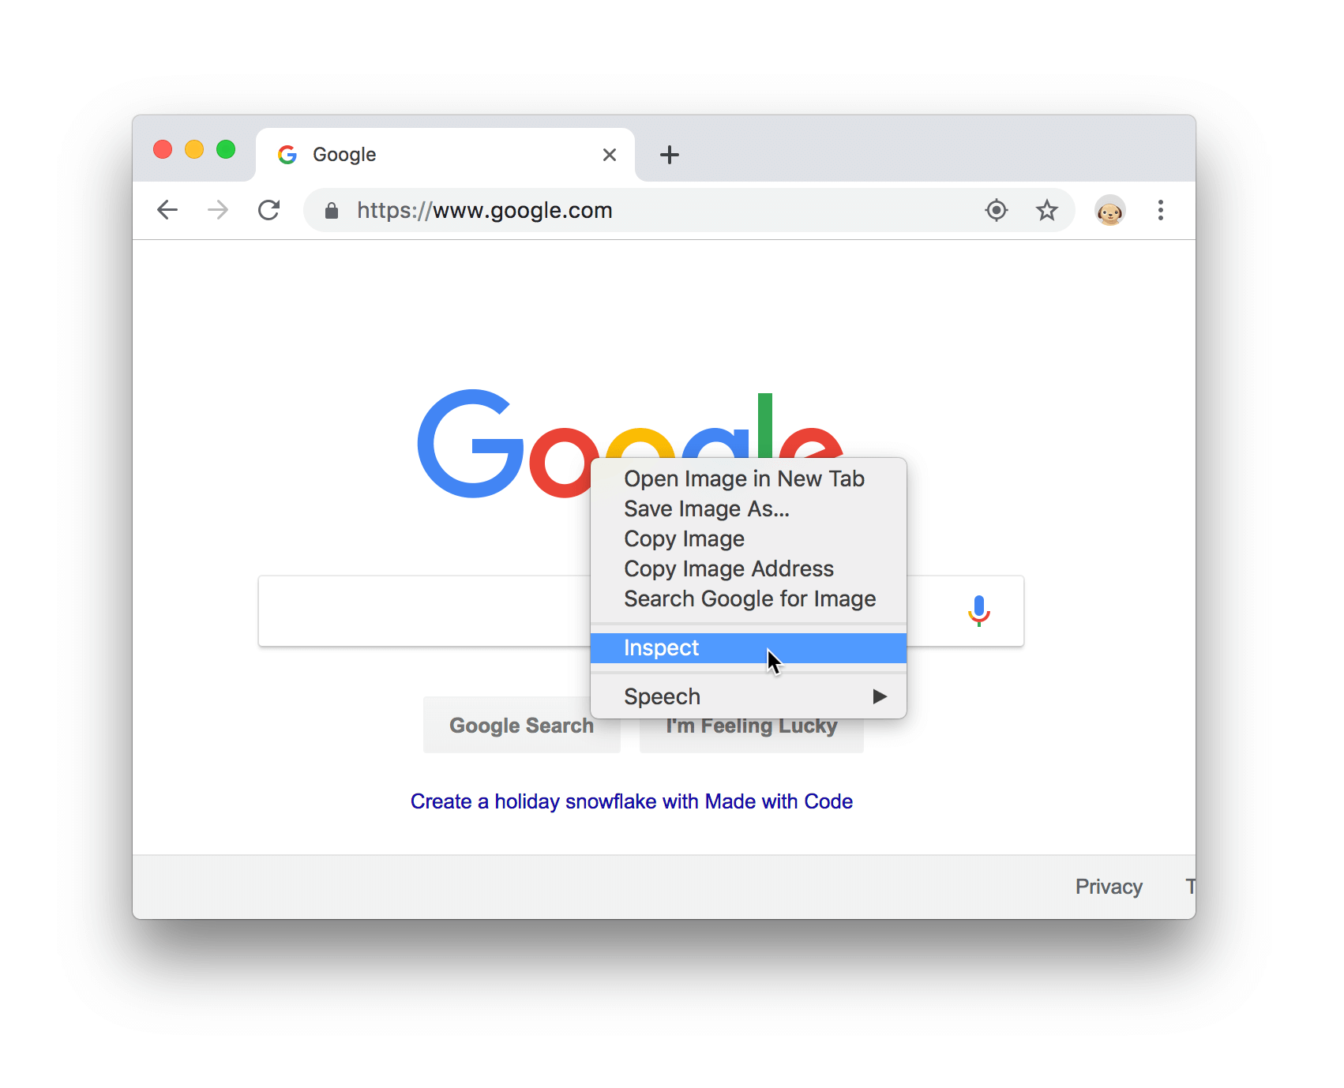
Exploring Web Elements
Click Customize and control Google Chrome and then select More Tools > Developer Tools.
Chrome Inspector:
Chrome DevTools is a set of web developer tools built directly into the Google Chrome browser.
Click Customize and then select More Tools > Developer Tools.
Right-click the element and select Inspect.

Slide 32
3. Selenium
Notes:
Oscar

Slide 33
Selenium Architecture and its Integration to Java

Slide 34
Selenium Architecture Components
Selenium Facts
Selenium is an Open-Source Automation Tool
It’s exclusively for Web Applications
It works with different browsers: Firefox, Chrome, Safari, Internet Explorer, Edge
Can run in different OS: Windows, Linux, Mac OS
Can use multiple programming languages: Java, C#, Python, JavaScript, Ruby

Slide 35
Selenium Architecture Components
Selenium IDE
It is an add-on to Chrome and Firefox web browsers, its main function is recording and playing back user actions on web pages; the recorded scripts can be saved to disk as HTML tables or exported to several different programming languages.
Selenium WebDriver *
It is mainly a framework allowing test scripts to control web browsers, enables test automators to combine WebDriver’s ability to control web browsers with the power of general programming languages.

Slide 36
Selenium Architecture Components
Selenium Grid
It enables running test scripts across multiple machines with different configurations. It allows distributed and simultaneous execution of test cases. It can be configured to use many physical or virtual machines with different combinations of operating systems and versions of web browsers.
Selenium Standalone Server
This tool is written in Java and is delivered as a jar file that implements hubs and nodes functions for Selenium Grid. This tool needs to be started separately (outside of test scripts) and configured properly to play its role in test environment.

Slide 37
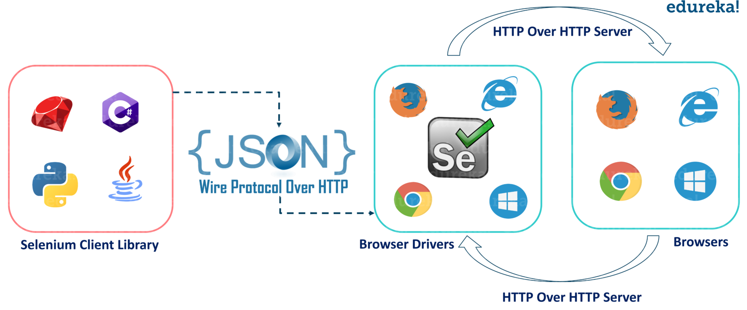
Selenium Architecture Components
Selenium Behavior Explanation

Slide 38
How to integrate to Java?
How Selenium and Java Work together?
Verify if Java is installed in your computer
Install Java if not installed before
Set Environment Variables: JAVA_HOME & Path
Install IDE(IntelliJ) and create test cases (Java Project & Class files)
Install Selenium (.jar files)

Slide 39
How to integrate to Java?
Exercise 2
Create our first test script to open the browser and navigate to test page:
Create class
Create Driver object
Set Driver properties (chromeDriver, geckoDriver, etc.)
Importance of Driver object
Open browser and navigate to a test page

Slide 40
How to integrate to Java?
Exercise 3
Run our first test in Chrome and Firefox
Set Driver properties (chromeDriver, geckoDriver, etc.)
Open browser and navigate to a test page
If Statement to select the correct Browser

Slide 41
Locators
What is a locator?
To perform most operations with WebDriver, you will need to locate the UI elements on which you want to operate in the currently active screen. This can be accomplished by using the find_element_ or find_elements_ methods within WebDriver.
Elements can be found by several different locators:
by_id (id_)
by_class_name (name)
by_name (name)
By_linkText (linkText)
by_xpath (xpath)
by_css_selector (css_selector)
Notes:
Oscar

Slide 42
Locators
By ID (Exercise 4)
Efficient
By definition, each ID should be unique in the HTML document
A tester can add IDs to the SUT easily
By Link Text (Exercise 5)
If the link text is unique to a page, you can find the element
The link text is visible to the user (in most cases), so it's easy to know what the test code is looking for
Partial link text is slightly less likely than the full link text to change

Slide 43
Locators
By XPath:
You can find elements that don't have any unique attributes (id, class, name, etc.)
You can use XPath in generic locators, using the different "By" strategies (by id, by class, etc.) as needed
By Class Name:
Class names can be used multiple places in the DOM, but you can limit the locating to the loaded page (for example on a popup modal dialog)
A tester can add class names to the SUT easily
Selenium does not accept class name with spaces

Slide 44
4. Web components automation
Notes:
Alexis

Slide 45
Understanding the DOM
Dynamic Object Model
Notes:
Alexis

Slide 46
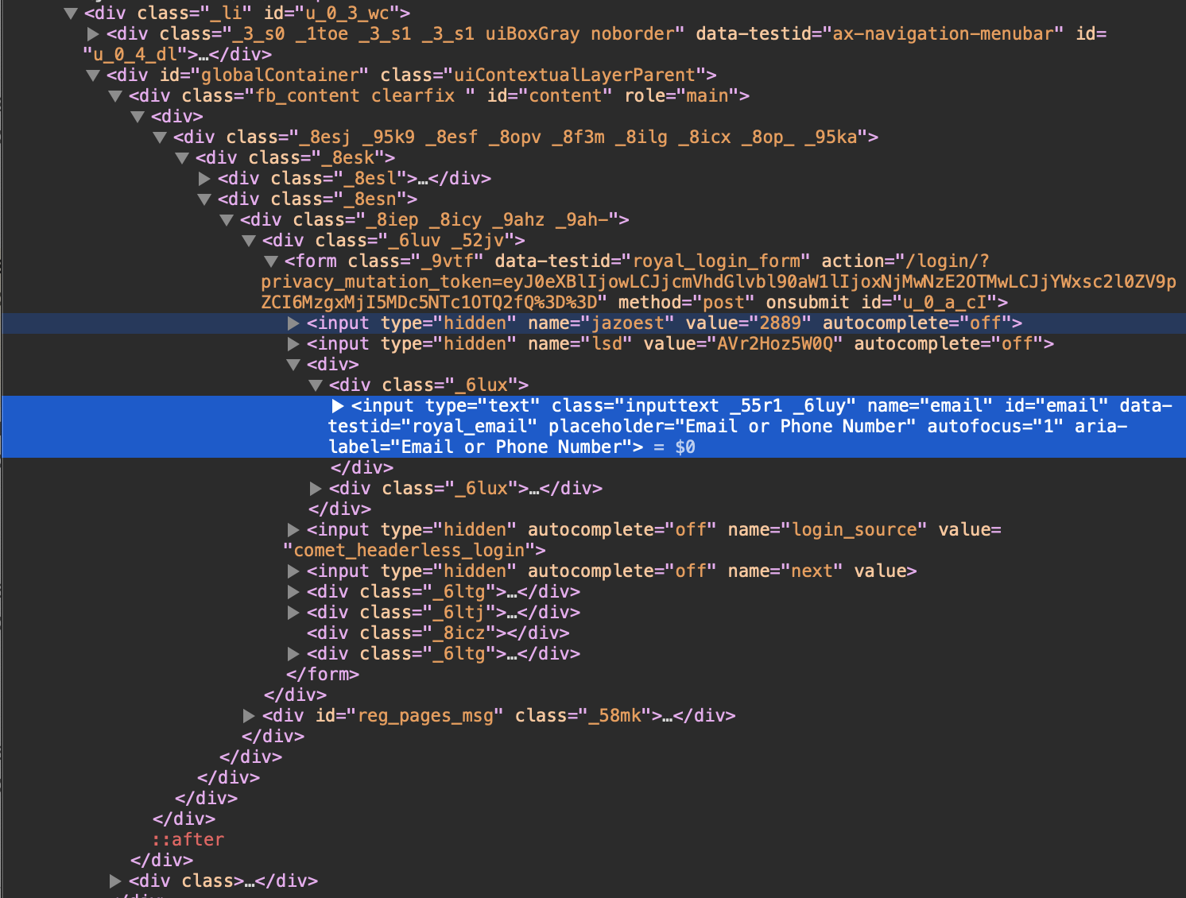
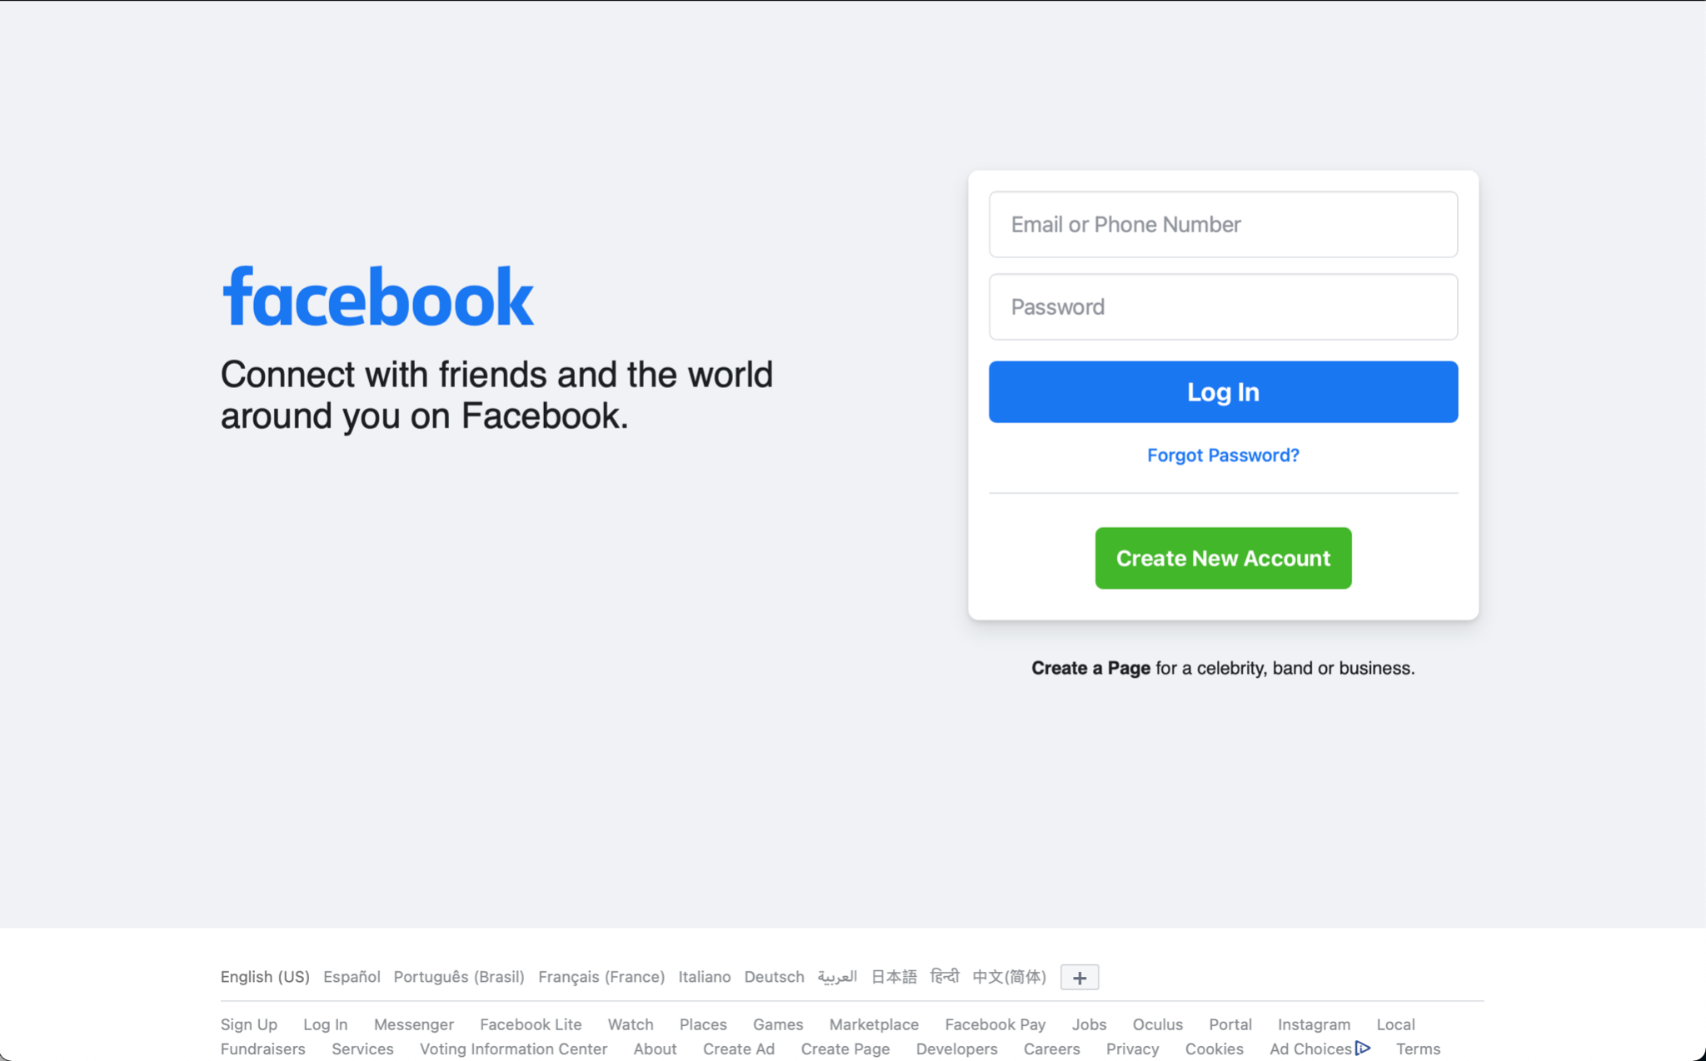
The Document Object Model (DOM)
Is the data representation of the objects that comprise the structure and content of a document on the web.
Represents the document as nodes and objects; that way, programming languages can interact with the page.

Slide 47
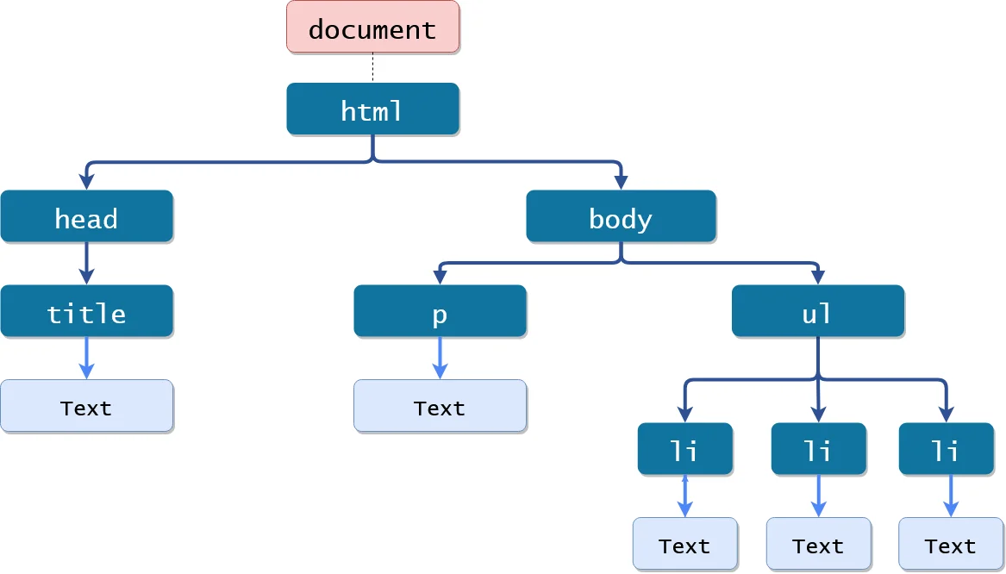
DOM Tree
Is a kind of tree whose nodes represent an HTML or XML document's contents. Each HTML or XML document has a unique DOM tree representation. For example, the following document
<html>
<head>
<title>My Document</title>
</head>
<body>
<h1>Header</h1>
<p>Paragraph</p>
</body>
</html>

Slide 48
Selenium Methods
Notes:
Alexis

Slide 49
Browser
3. Navigation
5. Switch
2. WebElement
4. Wait
Perform actions on a browser.
Perform actions on WebElements.
Load a web page, refresh a web page, or move backwards and forwards in our browser’s history.
Pause between execution statements.
Switch to alerts, windows, and frames.

Slide 50
Common Methods
Browser | WebElement | Navigation | Wait | Switch
get getCurrentUrl getTitle Close Quit | findElement click sendKeys getText getAttribute isDisplayed isEnabled | to refresh back forward | ImplicitWait ExplicitWait FluentWait | Switch to Frame Switch to Alert Switch to Window

Slide 51
Basic web components
Notes:
Alexis

Slide 52
Exercise 1 - Let’s go shopping
Go to https://www.saucedemo.com
Log in into the page
Search for the “Sauce Labs Backpack”
Click to see the item
Add to the cart
Go to the cart
Do the checkout
Continue to finalize your purchase

Slide 53
Exercise 2 - Let’s keep shopping
Go to https://www.saucedemo.com
Log in into the page
Add 2 items to the cart
Go to the cart
Go back to the Products
Add 1 item
Go to the cart
Do the checkout
Continue to finalize your purchase

Slide 54
Advanced web components
Dropdowns, tables, alerts, windows
Notes:
Jenny

Slide 55
Dropdowns
Notes:
Jenny

Slide 56
Dropdowns - What are these?
Dropdowns are HTML objects that are considered complex due to having WebElement inside elements:
There are two types:
Multiple
Simple <select id="continents" name="continents">
<option>Asia</option>
<option>Europe</option>
<option>Africa</option>
<option>Australia</option>
<option>South America</option>
<option>North America</option>
</select>

Slide 57
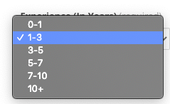
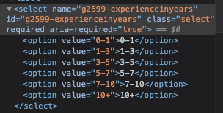
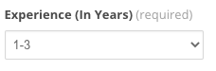
Dropdowns - How to instantiate a Select
org.openqa.selenium.support.ui.Select
With this library we can select all options (if multiple option is available)
Deselect and select by index
Deselect and select by value
Deselect and select by visible text
Verify if it allows multiple selections
Get list of all selected options
Notes:
https://www.seleniumeasy.com/test/basic-select-dropdown-demo.html
https://demoqa.com/automation-practice-form
https://www.seleniumeasy.com/test/jquery-dual-list-box-demo.html

Slide 58
Dropdowns - Available methods to interact in Selenium WebDriver
org.openqa.selenium.support.ui.Select
The instance of this object would be:
private static final String YEARS_EXPERIENCE_XPATH = “?”;
Select dropDownYearsExperience = new Select(driver.findElementByXpath(YEARS_EXPERIENCE_XPATH));
After instantiating this object, we will have access to methods in previous slide, such as:
Boolean isMultipleOption = dropDownYearsExperience.isMultiple();
or
dropDownYearsExperience.selectByValue(“0-1”);
Notes:
deselectAll() - Quita todas las opciones que pudieran estar seleccionadas ( si es de opción múltiple)
deselectByIndex(índice_a_deseleccionar) - Deselecciona por número de opción, según el orden de opciones
deselectByValue(“valor_a_deseleccionar”) - Deselecciona por valor (atributo value)
deselectByVisibleText(“texto_visible”) - Deselecciona por el texto
getAllSelectedOptions() - Obtiene una lista de WebElement con todas las opciones seleccionadas
getFirstSelectedOption() - Obtiene la primer opción seleccionada, solamente
getOptions() - Obtiene una lista de WebElements con todas las opciones, seleccionadas o no
isMultiple() - Verdadero/falso, si es de opción múltiple o no
selectByIndex(numero_a_seleccionar) - Selecciona por número de opción según el orden donde se encuentra
selectByValue(“valor_a_seleccionar”) - Selecciona la opción de acuerdo al valor (atributo value)
selectByVisibleText(“texto_visible”) - Selecciona la opción que se ve en el texto de la opción

Slide 59
Agenda Day 2
9:00 - 10:30 | Jenny | Automating web components
10:30 - 10:40 | All | Break
10:40 - 12:00 | Jonathan | Verifications and assertions
12:00 - 13:00 | All | Lunch time
13:00 - 13:30 | Alejandra (TA) | ITJuana Open Positions, how to apply
13:30 - 15:00 | Oscar | Appium
15:00 - 15:10 | All | Break
15:10 - 16:30 | Oscar | Appium
16:30 - 16:40 | All | Break
16:40 - 18:00 | Oscar | Appium & QA
18:00 - 18:15 | Ever & All | Event closure

Slide 60
Table

Slide 61
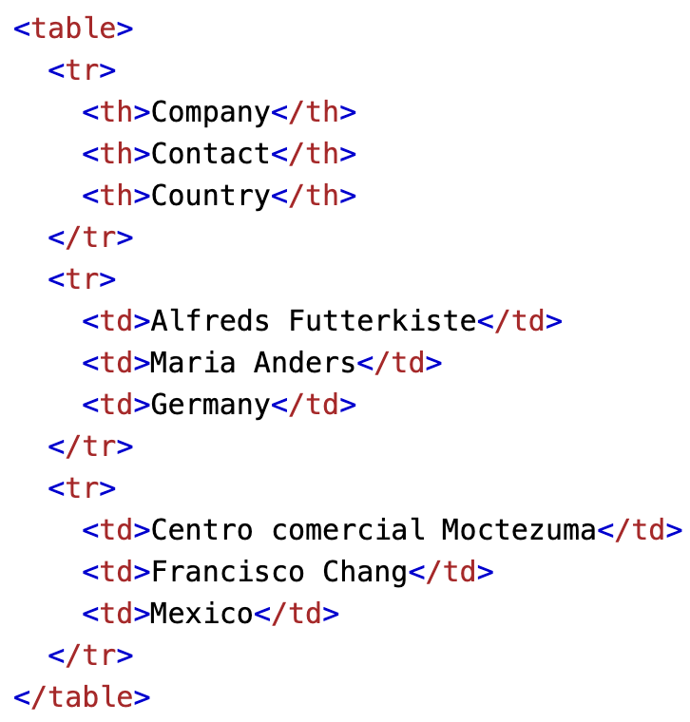
Table - What are these?
Tables are complex HTML components, tables usually consist of 3 main components:
Table <table>
Rows <tr>
Columns <td> or <th>
Ref
Notes:
https://www.seleniumeasy.com/test/table-search-filter-demo.html
https://www.seleniumeasy.com/test/bootstrap-date-picker-demo.html

Slide 62
Table
No special libraries
Tables can be nested
Best way to access a table data is by XPATH
Notes:
https://www.seleniumeasy.com/test/table-search-filter-demo.html https://demoqa.com/books

Slide 63
Alerts
Notes:
https://www.seleniumeasy.com/test/javascript-alert-box-demo.html

Slide 64
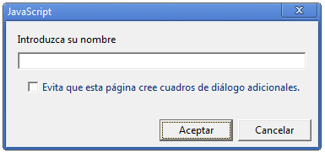
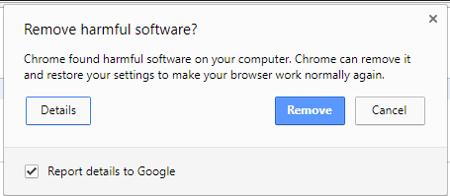
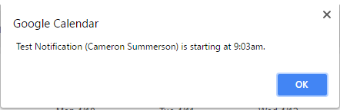
Alerts - What are these?
Alerts are small windows usually with a notification or small request that are prompted by the browser, some important facts are:
Alerts may request data from user
Are prompted by JavaScript (as every functionality in a browser)
Alerts are different from Modals (HTML div that works as an alert)
CSS modals will also be discussed
Notes:
https://www.seleniumeasy.com/test/bootstrap-alert-messages-demo.html

Slide 65
Alerts - How to use it
import org.openqa.selenium.NoAlertPresentException;
import org.openqa.selenium.Alert;
To navigate to alerts we’d usually use the driver.switchTo() method, for example:
chromeDriver.switchTo().alert().dismiss(); - Cancels alert
chromeDriver.switchTo().alert().accept(); - Accepts alert
chromeDriver.switchTo().alert().getText(); - Reads alert text
chromeDriver.switchTo().alert().sendKeys("Text"); - sends text to alert textbox (if applicable)
Notes:
https://www.seleniumeasy.com/test/bootstrap-modal-demo.html

Slide 66
Windows

Slide 67
Window handler - What are these?
Browsers can open new windows and Selenium has a special library to manage this behaviors, the usual behavior is by:
Iterating the available windows
Creating a Set of available windows
Keeping track of first or main window
Libraries available are:
import java.util.Iterator;
import java.util.Set;

Slide 68
Window handler - How to use it
WebDriver allows to manage windows with methods:
chromeDriver.manage().window().maximize() - To maximize a window
String mainWindow = chromeDriver.manage().getWindowHandles() - To keep main window identificator
Set<String> windowsToIterate = chromeDriver.getWindowHandles(); - To get all available opened windows (from WebDriver)

Slide 69
Window handler - How to use it
Iterator<String> windowIterator = windowsToIterate.iterator(); -
Use a buckle method to iterate (for, while, foreach, etc.) Ex:
while(windowIterator.hasNext()) {
String childWindow = windowIterator.next();
//Finding main window
if(mainWindow.equalsIgnoreCase(childWindow){
chromeDriver.switchTo().window(mainWindow);
}
}
Notes:
https://demoqa.com/browser-windows

Slide 70
iframes

Slide 71
IFRAMES - What are these?
Are used to embed a document within the HTML (for example YouTube videos)
iframes are managed very similar to Windows in WebDriver:
Frames can be found by index, name or id or WebElement.
It is important to note that even when out
Example:
chromeDriver.switchTo().frame(0) - Index
chromeDriver.switchTo().frame(“myiframe”);
Notes:
https://demoqa.com/frames

Slide 72
IFRAMES - Important information
It’s always advised to have in mind the order of frames if nested
Also function chromeDriver.switchTo().parentFrame() - takes WebDriver back to parent page or iframe.
Notes:
https://demoqa.com/frames

Slide 73
5. Waits in Selenium
Implicit and Explicit
Notes:
Jonathan

Slide 74
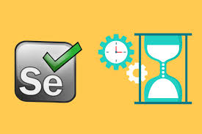
Waits in Selenium
What are wait commands?
Waits in Selenium are the way that We can say to driver that have to wait for some time until all element in the UI interface are available due to every single items loads in different time, sometimes there are kind of lag time.

Slide 75
Types of Waits
Implicit wait:
driver.manage( ).timeouts( ).implicitlyWait(10, TimeUnit.SECONDS);
“NoSuchElementEception”
Explicit wait:
“Thread.sleep();” “WebDriverWait with ExpectedCondition”
//Explicit Wait
WebDriverWait wait = new WebDriverWait(driver, 10);
wait.until(ExpectedCondition.titleContains(“Swag”));
“TimeOut Exception”

Slide 76
6. Verifications and Assertions
Notes:
Jonathan

Slide 77
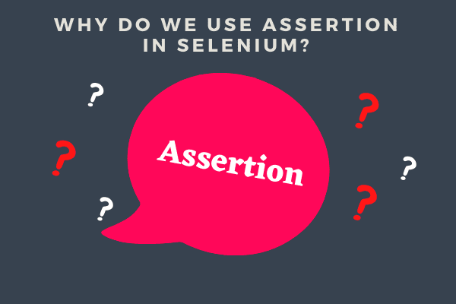
Asserts and Verify methods in Selenium
In Selenium the asserts and verify are used for verifying or validate applications, it means it make sure that actual result and expected result be match.​
Asserts return Boolean value it means:​
if return is True that verification is passed and the test can will continue or finish the test.. ​
If return is False that verification get an AssertionError Exception and it will be failed.

Slide 78
Types of Asserts
Hard Assertions:
In case of Assertions, if the Assert condition is not met, the test case execution will be aborted and the test case will be marked as failed.
Hard assertions ex:
assertsEquals()
assertNotEquals()
assertTrue()
assertFalse()
assertNull()
assertNotNull()
Start
e = Expected result
a = Actual result
AssertEquals(e, a)
False
Assertion ErrorExeption
True
Continue...
Finish

Slide 79
Types of asserts
Soft Assertions
In case of Verify, the test case execution will continue until the end of the test even if assert condition is not met.
Soft assertions ex:
softAssert.assertEquals()
softAssert.assertNotEquals()
softAssert.assertNull()
softAssert.assertNotNull()
softAssert.assertTrue()
softAssert.assertFalse()
Start
e = Expected result
a = Actual result
AssertEquals(e, a)
False
Assertion ErrorExeption
True
Continue...
Continue...

Slide 80
Exercise:
Using the “Let’s go shopping” exercise that you did before:
Validate with an Assert if the page title is “Swag Labs”.
Validate that all item are visible.
Validate if “Sauce Labs Fleece Jacket” already exist in the page.
Validate that page title of cart is not “Ready to Shopping”.
Validate if Sauce Labs Fleece Jacket was added to cart.
Click on remove button.
Validate if Sauce Labs Fleece Jacket was removed from cart.
Click to Continue shopping..
Add Test.allTheThings() T-Shirt (Red) to cart >> Go to cart.
Validate that T-Shirt (Red) is already on cart >> Do checkout..
Complete checkout.

Slide 81
7. Appium
Notes:
Oscar

Slide 82
Appium Features
Some things you should know about Appium:
Appium is an open-source Automation tool
It supports multiple platforms for Automation (Android, iOS)
Can work with Native, Hybrid and Mobile Web Apps
It shares a lot of common functionalities with Selenium
Can be written in multiple languages (Java, Phyton, etc.)
It requires an Appium Server to work (Node.js)

Slide 83
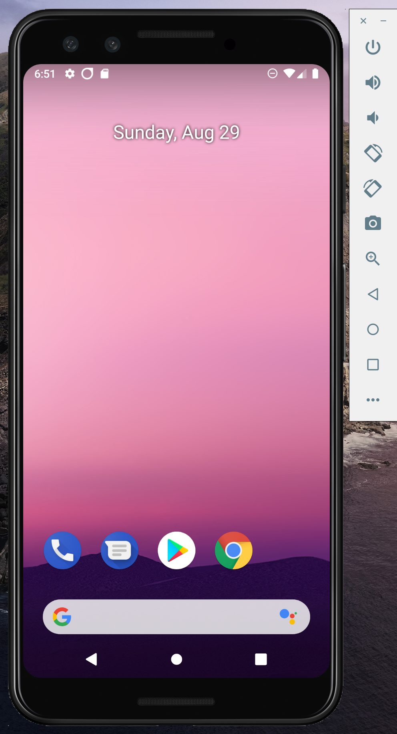
Setup Android Emulator
Let's setup Android Emulator with Android Studio
AVD Manager

Slide 84
Desired Capabilities
What are desired capabilities?
Desired Capabilities are just a set of keys and values that get sent to the Appium server during session initialization, that tell Appium what kind of thing we want to automate. The minimum set of required capabilities for any Appium driver should include:
platformName: the name of the platform to automate
platformVersion: the version of the platform to automate
deviceName: the kind of device to automate
app: the path to the app you want to automate (but use the browserName capability instead in the case of automating a web browser)
automationName: the name of the driver you wish to use

Slide 85
Appium Exercise 1
Launch the App in your Virtual Device

Slide 86
Appium Exercise 2
Use UIAutomatorViewer to inspect objects and build your first script with XPath and Text

Slide 87
Appium Exercise 3
Gestures in Automation (TouchActions)

Slide 88
Test Automation Bootcamp: We start at 9am (PST) This time is for Settings or other questions and answers

Slide 89

Test Automation Bootcamp:

